Slide 1
Video Object Segmentation
over
Space and Time
Elena Burceanu @eburceanu

Slide 2
20 min challenge: Math concepts can be extremely useful, easy and close to real life (security related) problems!

Slide 3
Video Object Segmentation
Given a video of a dynamic object, discover it!
Unsupervised: just by watching the video
Semi-Supervised: knowing 1st frame GT
Why is it useful?
Fundamental task in Computer Vision
Video editing, Robotics, Self-driving cars, Video Surveillance
Video Object Segmentation: Intro

Slide 4
Intuition
Video = space-time volume
A slice = one frame
Start with an imperfect segmentation
Add missing parts of the object
Remove the noise coming from other objects
Fix it along multiple iterations
The main object segmentation = the strongest cluster in pixels graph
Video Object Segmentation: Intro MoSculp [Zhang et al., UIST 2018]

Slide 5
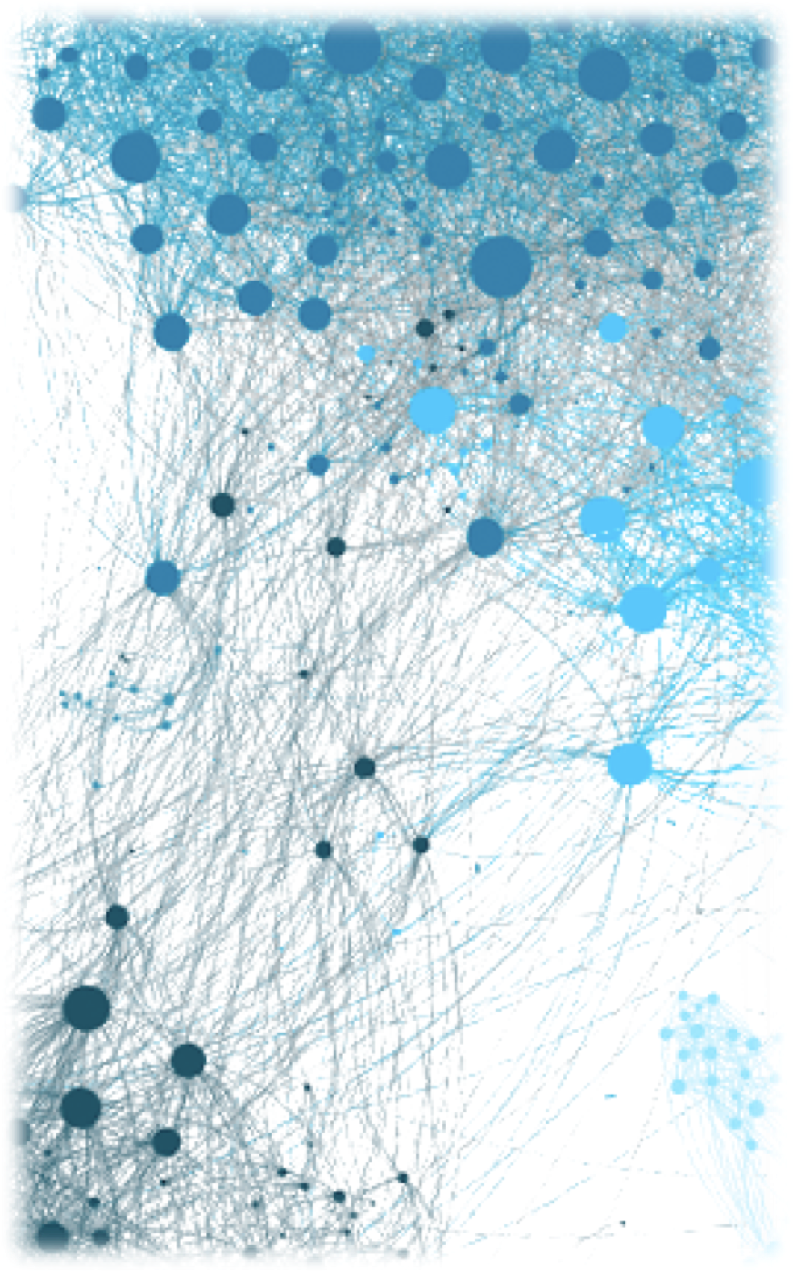
Clustering Intro
Clustering
Divide data points (nodes) into groups
Very similar inside a group => need a similarity function
Similarity between any two nodes => edges
Graph
Custom ways of describing the relations
Based on unary (nodes) + pairwise (edges, 2 nodes) terms
Similarity Matrix to fully describe the dataset structure
Spectral Clustering
Good Similarity Matrix for Good Clustering
Leading eigenvector gives the clustering labels
Video Object Segmentation: Math

Slide 6
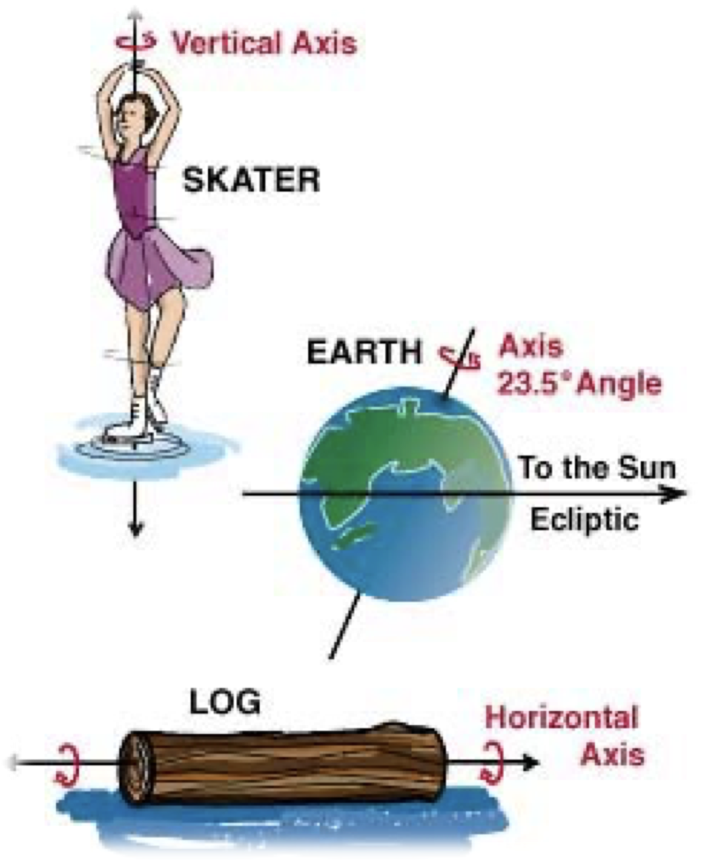
Eigenvectors Intro
Matrix A
Compact representation of a linear projection
Maps vectors ($x$) in other vectors ($y=Ax$)
When apply A, eigenvectors of A ($Ax=λx$)
Keep their direction
Change the magnitude (optional)
Derived to study the planets axis of rotation ($v$)
Find the vector that does not change when rotated
$Rv=v$
Video Object Segmentation: Math

Slide 7
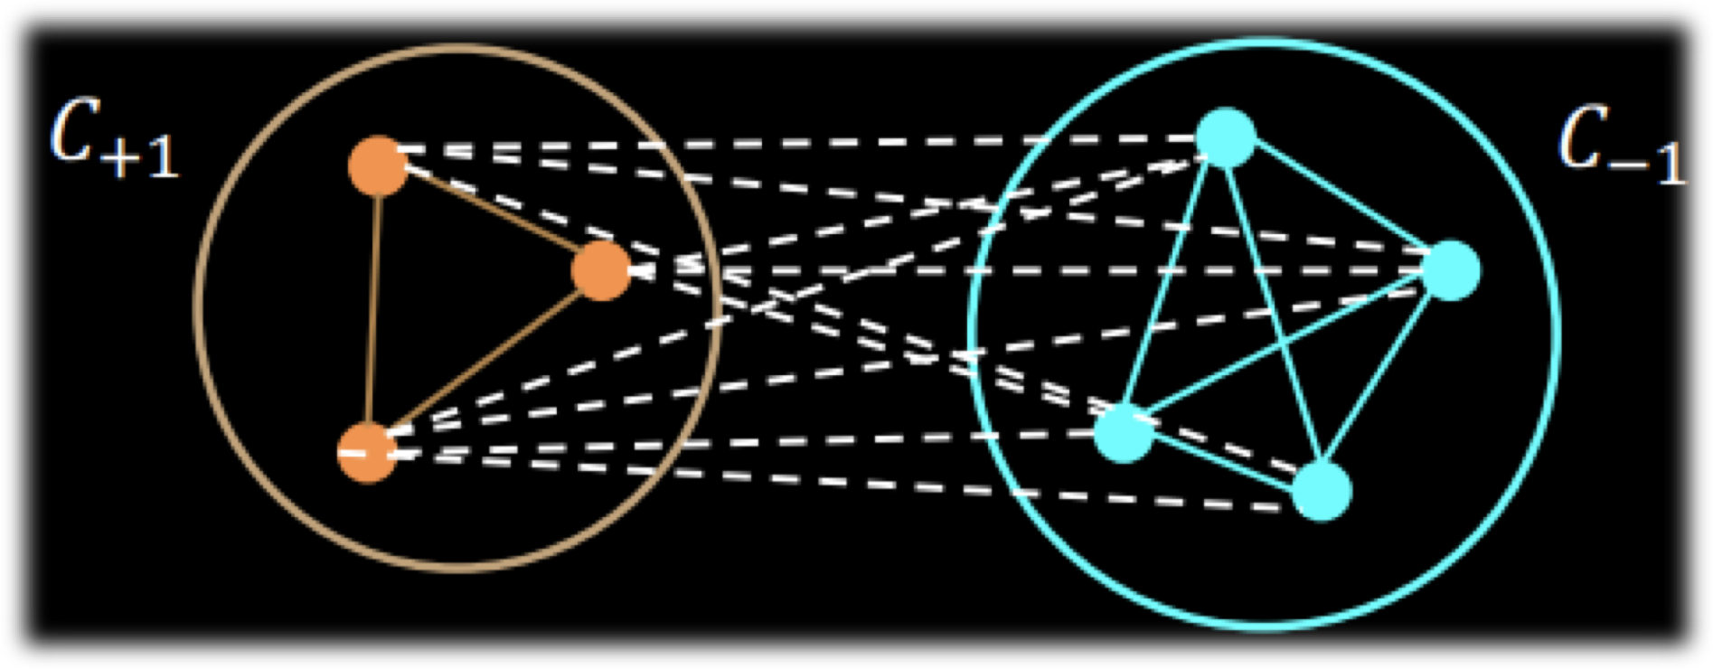
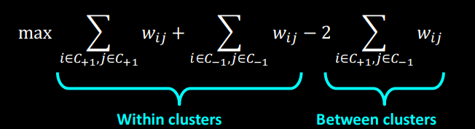
Eigenvector for Clustering
Maximize the score (based on similarity):
For contiguous domain labelling:
Rayleigh Quotient => solution for $x$ is the Leading Eigenvector of the
Similarity Matrix
Video Object Segmentation: Math

Slide 8
Computing Eigenvectors
Computationally very expensive
Unless the graph/matrix is sparse
Power Iteration
Several iterations
Normalize after each one
Converges to the principal eigenvector of M, $∀x$
PageRank
N domains x N domains
Similarity: is there a link between the domains?
$$x→Mx→M^{2}x→M^{3}x→...$$
Video Object Segmentation: Math

Slide 9
Notes:
Start with a PERFECT video segmentation for an object
Make it NOISY (blur and uniform noise)
Recover the initial segmentation using the SFSeg filtering

Slide 10
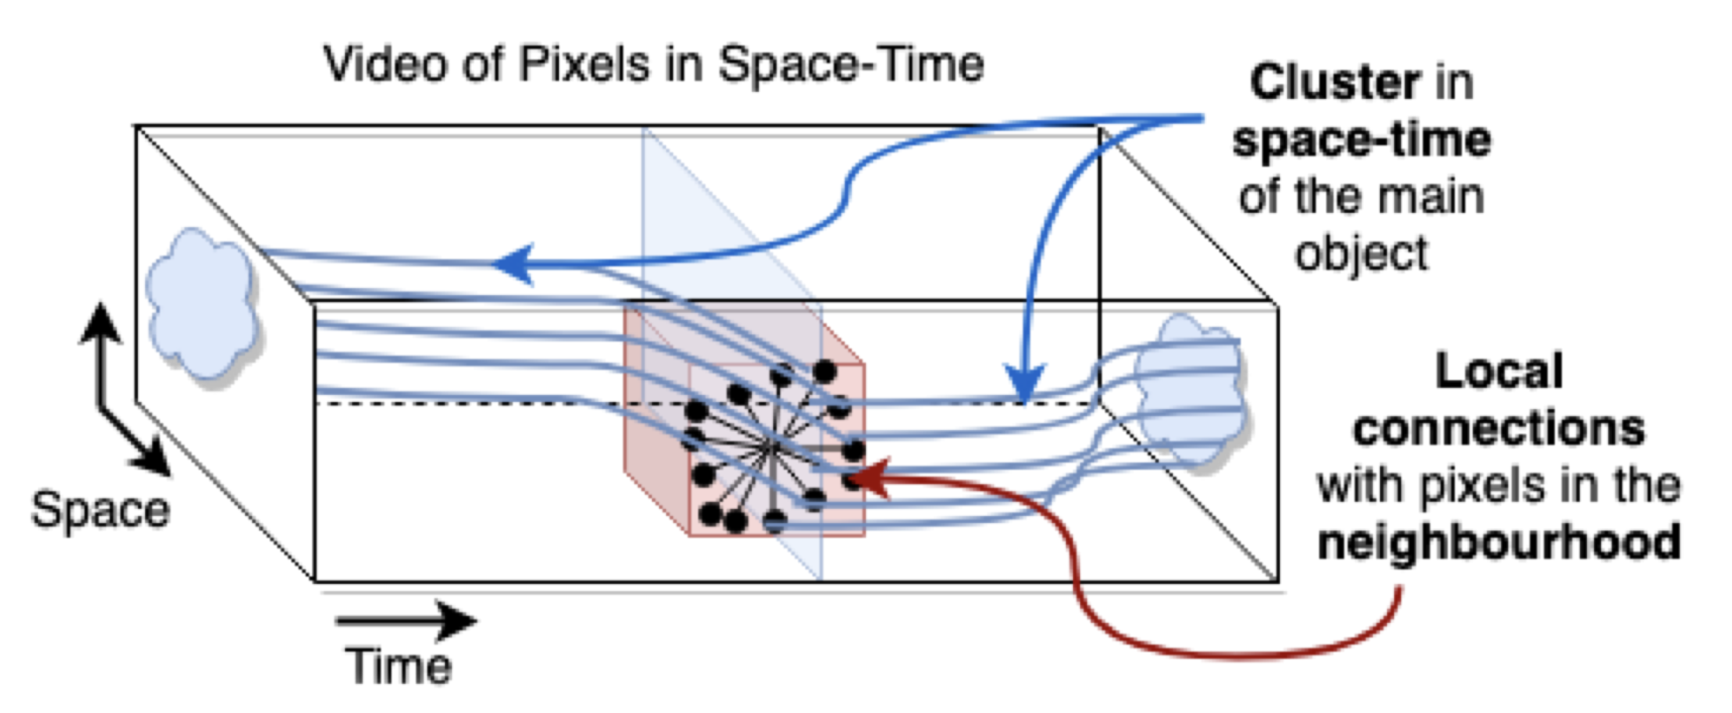
Eigenvectors in Video Segmentation
Find the strongest cluster
Build an similarity matrix
Principal eigenvector
Main object segmentation
Preserve object consistency in space-time, pixel-level
A Graph Partitioning problem in space-time
Nodes = pixels; their Relations = space-time neighbourhoods
Video Object Segmentation: SFSeg - Our Solution

Slide 11
Sounds good in theory…
Pixels in a video
Small video: 50 frames (time)
480 x 854 (space) => ~20 millions pixels
The similarity matrix for video pixels
N x N ~ $4∗{10}^{14}$ elements
Finding the principal eigenvector - impossible in reasonable time
Video Object Segmentation: SFSeg - Our Solution

Slide 12
Simple Observation for SFSeg
Ingeniously rewrite Power Iteration recurrence
Without building the similarity matrix explicitly
Taylor Series Approximation -> Convolutional Filters formulation
Fast GPU implementation
from impossible to 0.06 sec/frame
Improves over state of the art solutions
80% of videos
1.6% IoU boost
Video Object Segmentation: SFSeg - Our Solution

Slide 13
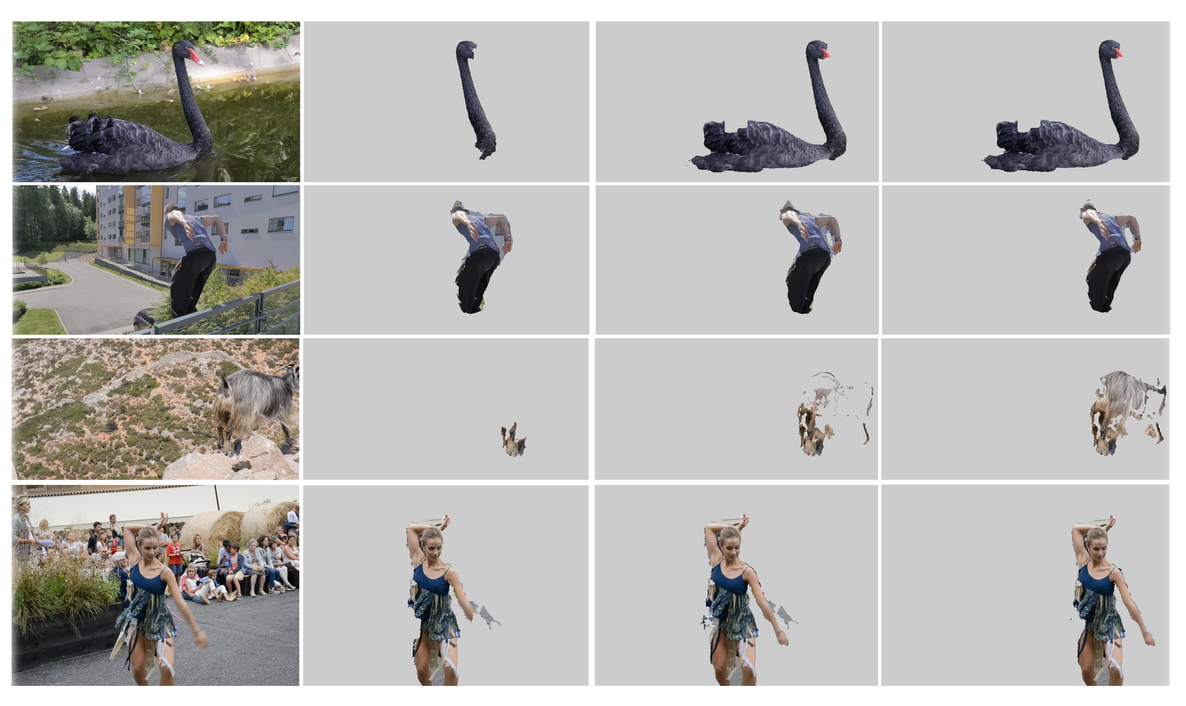
Qualitative Results
Multiple Iterations
Video Object Segmentation: Results

Slide 14
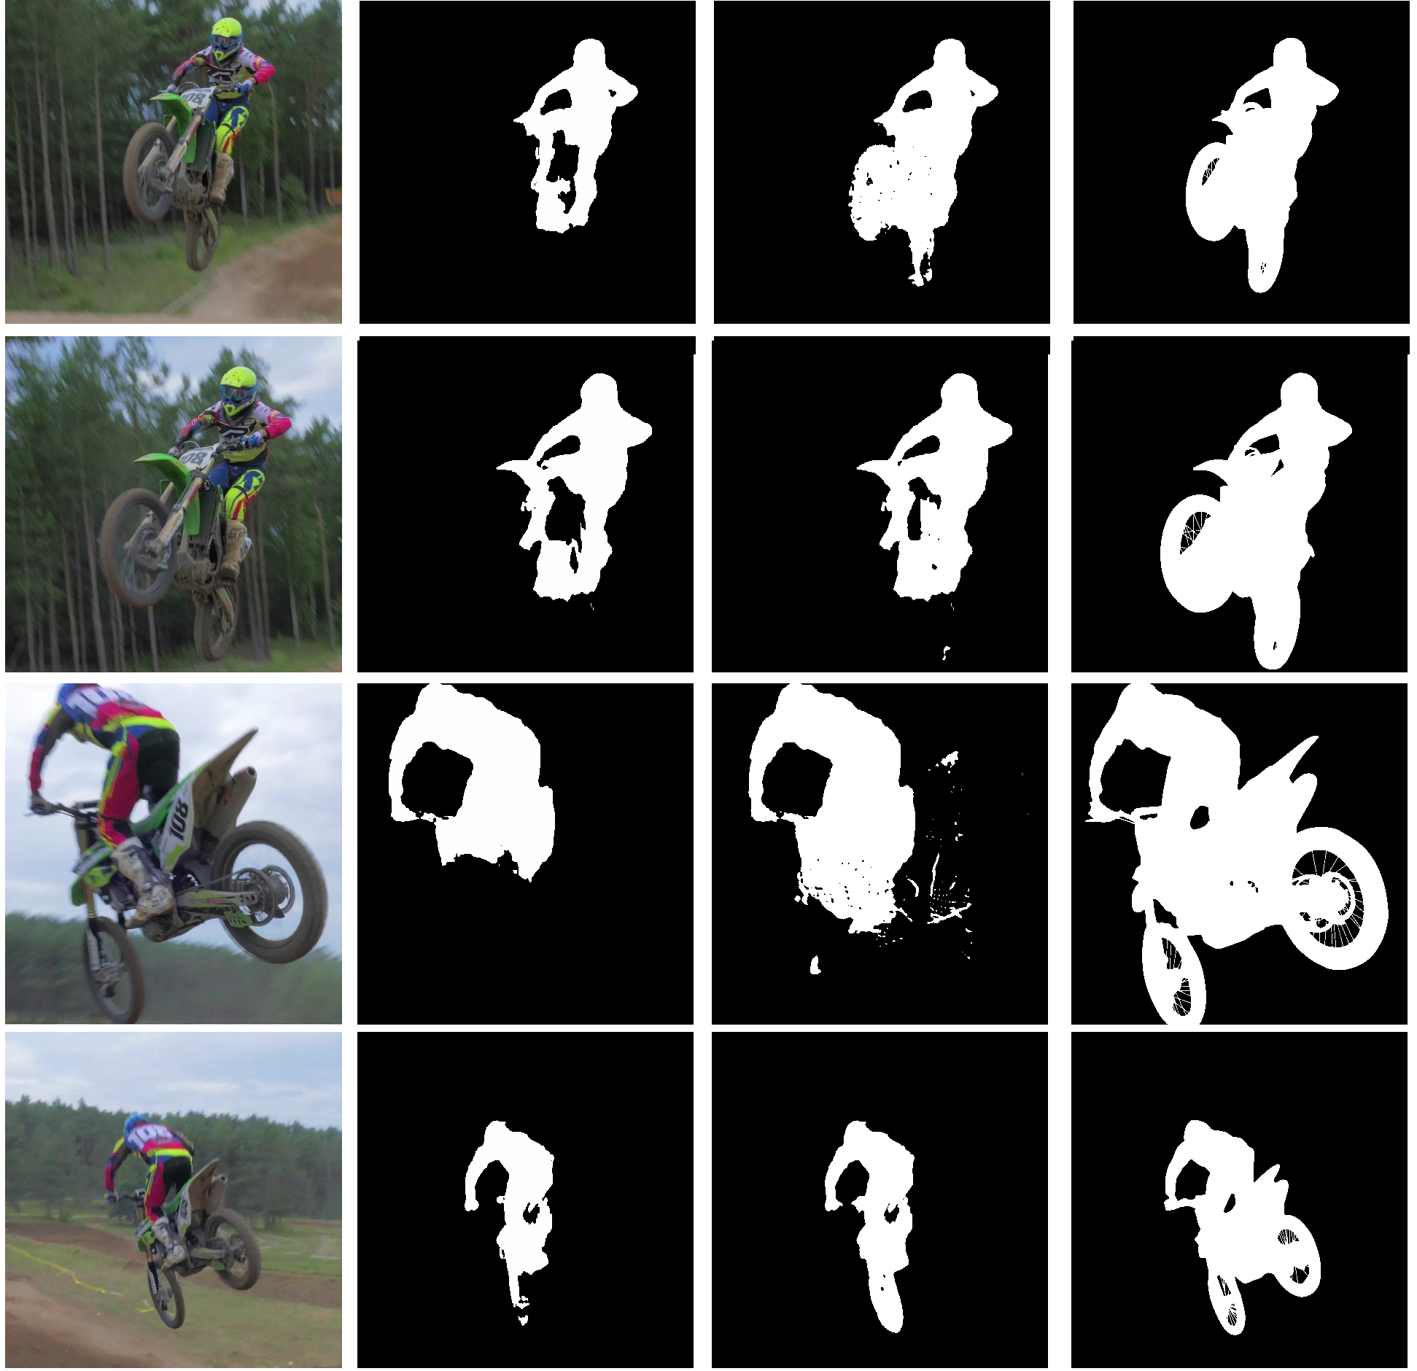
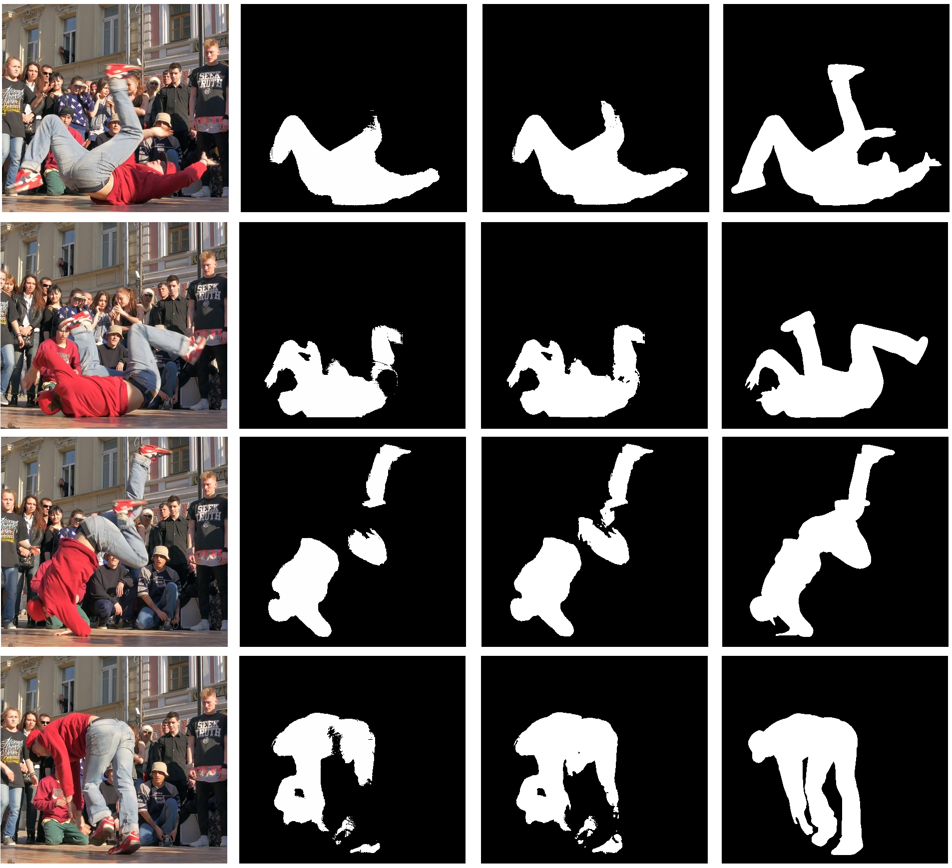
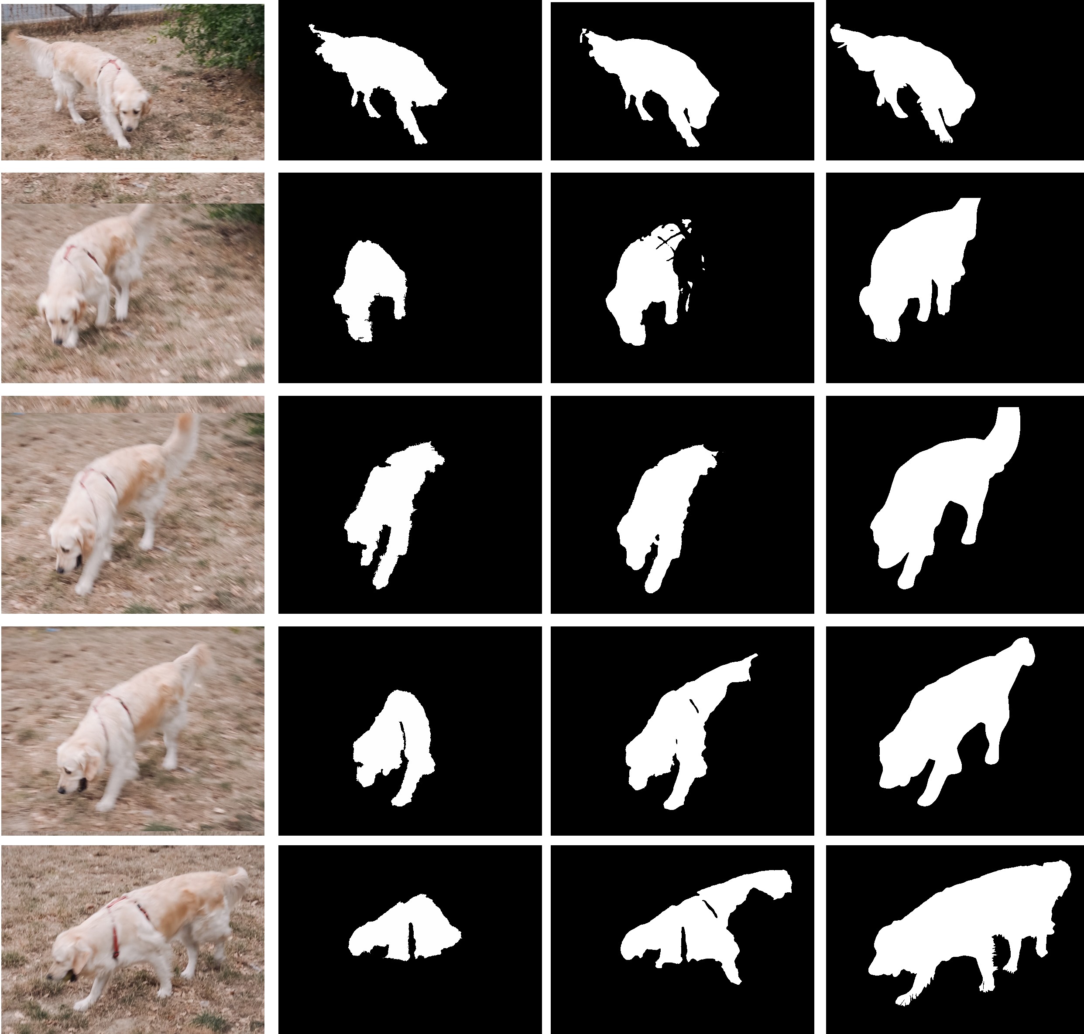
Qualitative Results
Video Object Segmentation: Results

Slide 16
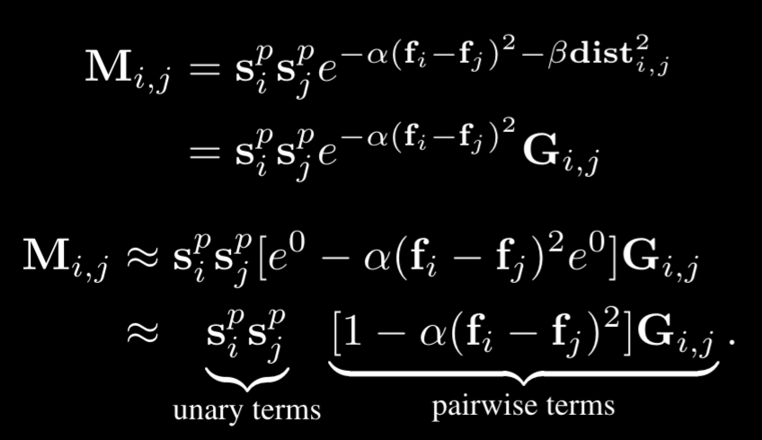
Some formulas
Power Iteration Equation
Rewrite Power Iteration using
Convolutional Filters and
Taylor Series Approximation
Without building the matrix explicitly
Similarity Matrix
Video Object Segmentation: SFSeg - Our Solution

Slide 17
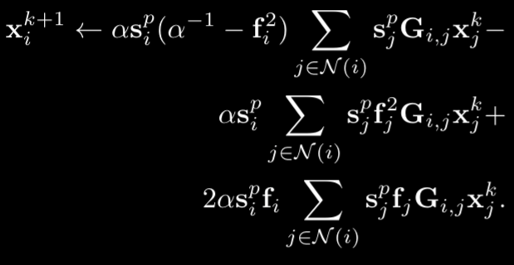
Some other formulas
Power Iteration Equation:
Convolutional Formulation:
Video Object Segmentation: SFSeg - Our Solution

Slide 18
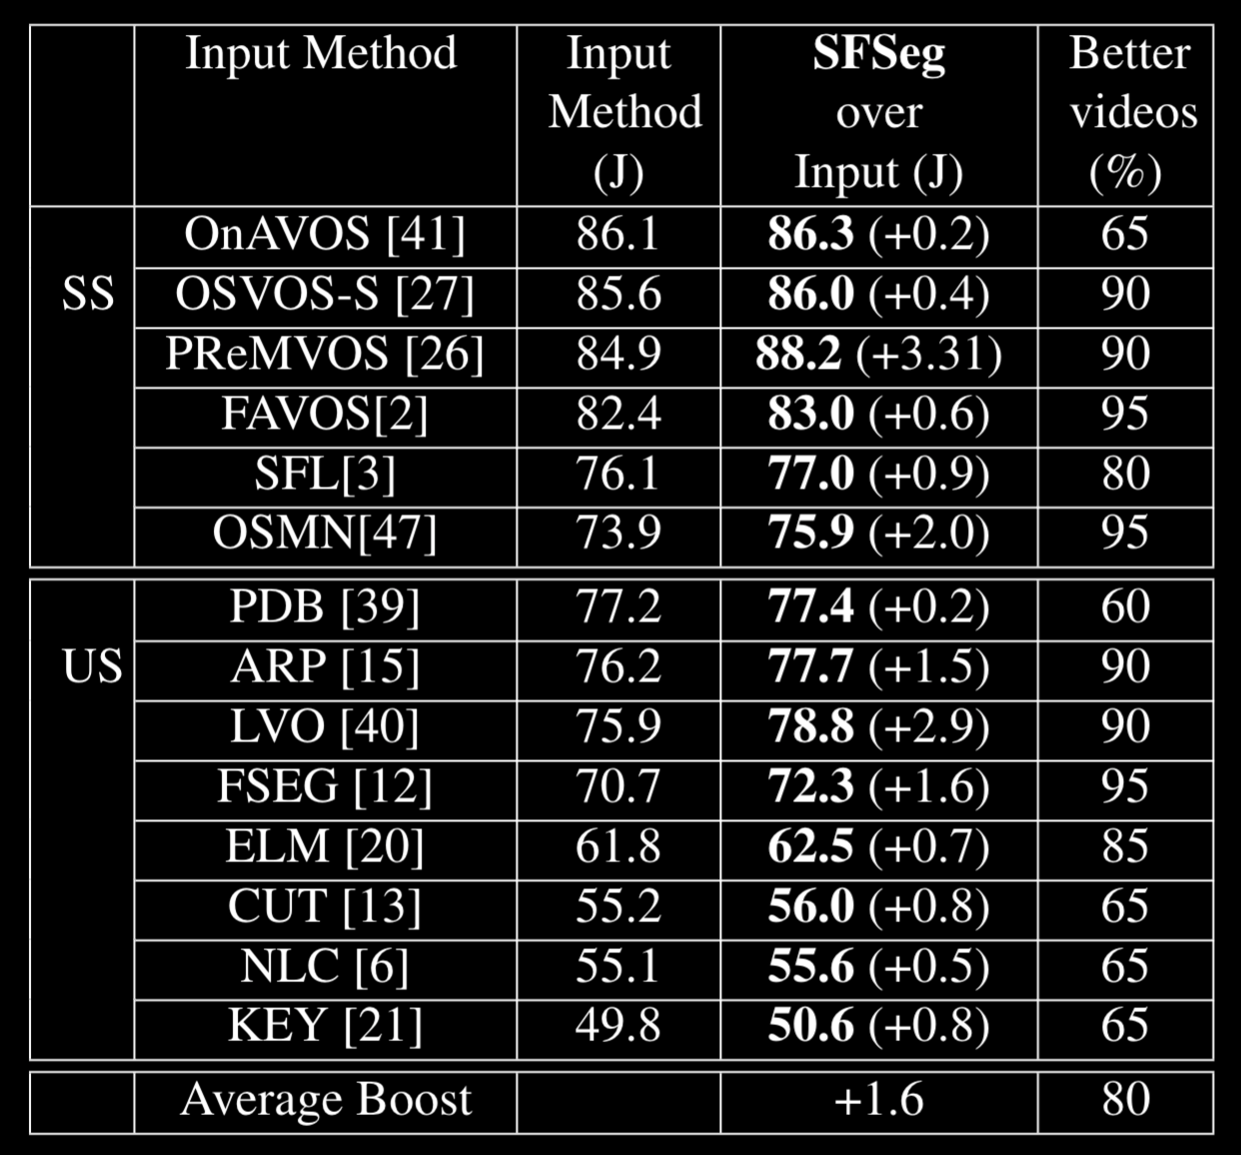
Quantitative Results
Consistently improves over SOTA
80% of videos, 1.6% in IoU
Small additional computational cost
0.06 sec/frame/iteration
5 iterations for convergences
Complementary approach
not addressed by current solutions
Video Object Segmentation: Results

Slide 19
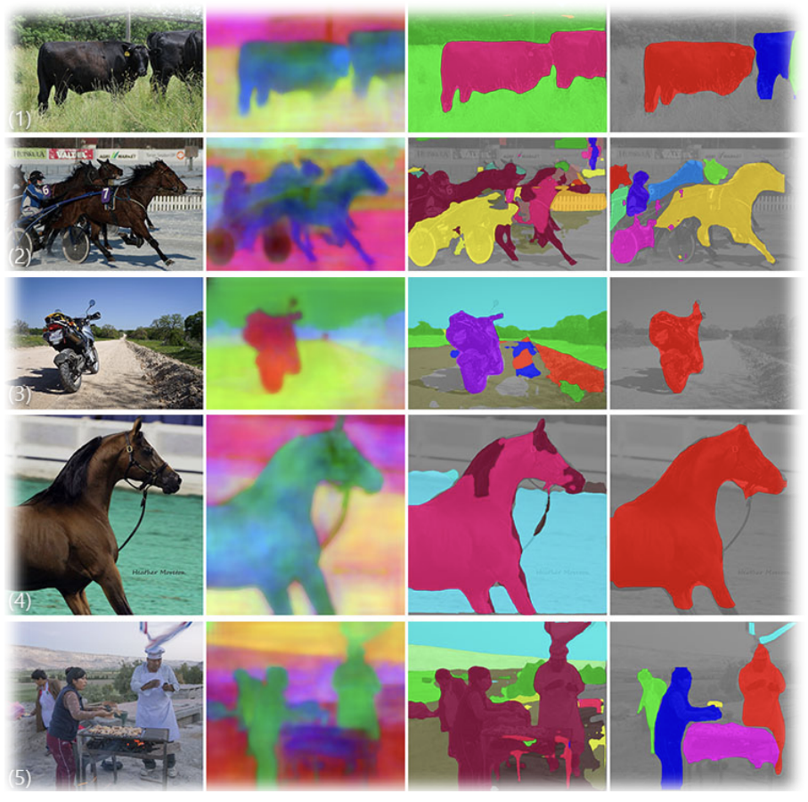
Useful?
Why accurate video segmentation:
Better decomposition of the scene
Self-driving cars
Discover objects of interest in the video
Separate BKG from FG (auto)
Precise shape and boundary of the object
Medical images
Cut out/Replace specific objects
Video Object Segmentation: Utility

Slide 20
Cool or Scary?
Private Video Surveillance Concept
Computer Vision empowered by Crypto
Video
Visual is a rich flow of info
Leak of unwanted/unauthorized info
Use it only for the exact declared use cases
Eg.: Each parent should be able to monitor only his/her child
Video Object Segmentation: Utility

Slide 21
Thank you! Questions?
Our full team and projects:
bit-ml.github.io
Elena Burceanu
@eburceanu

